Slide 1





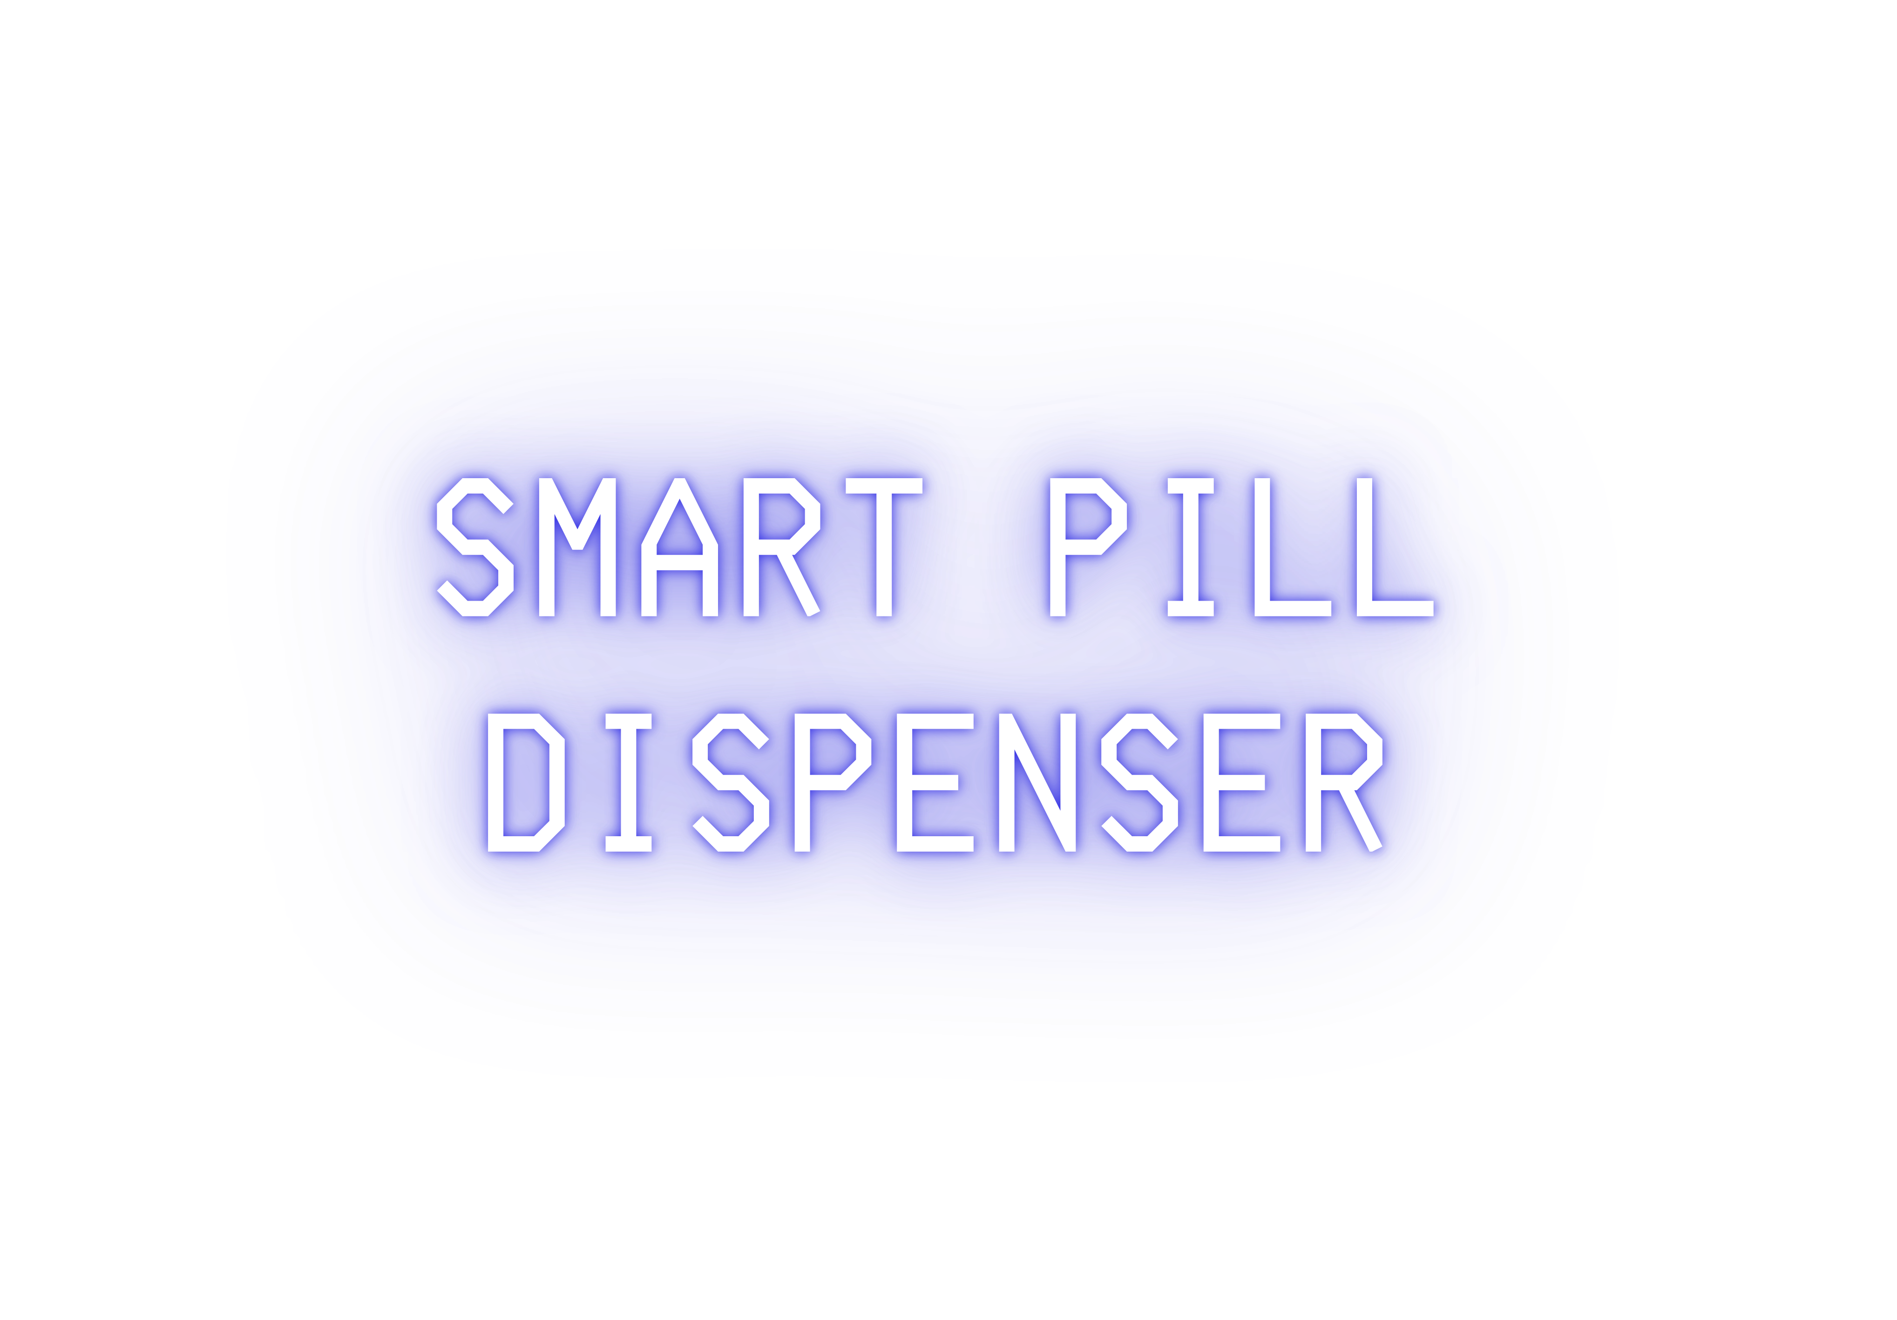
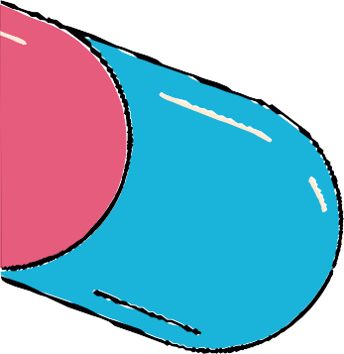
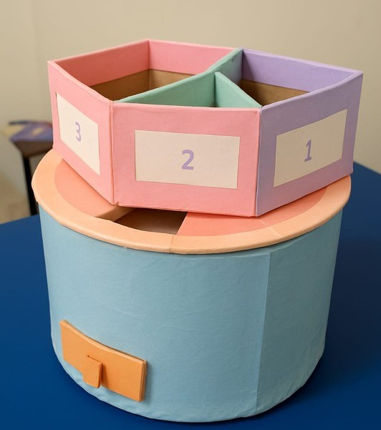

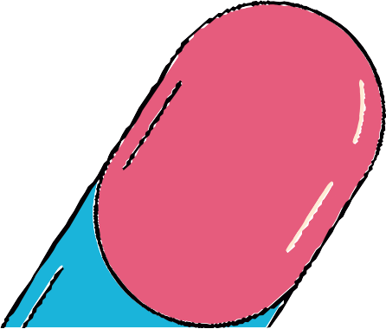

Slide 2






2 ND Y E A R 3 R D S E M
Sankalan Pal (Leader & Presenter)
Puskar Nath (Researcher & Presenter) Shayak Sarkar (Researcher)
Aniraj Saha (Visualization) Samadrita Datta (Designer) Pameli Saha (Designer)

Slide 3

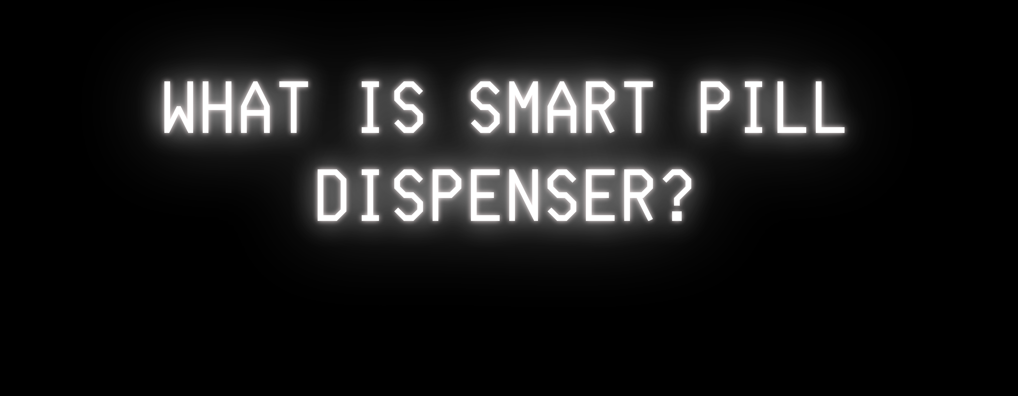
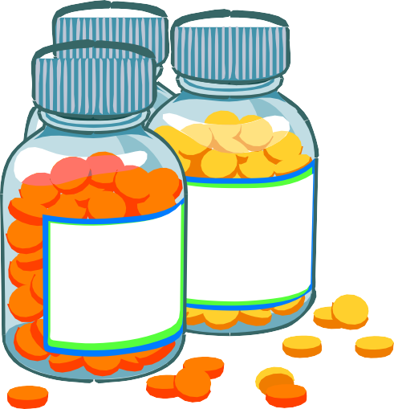








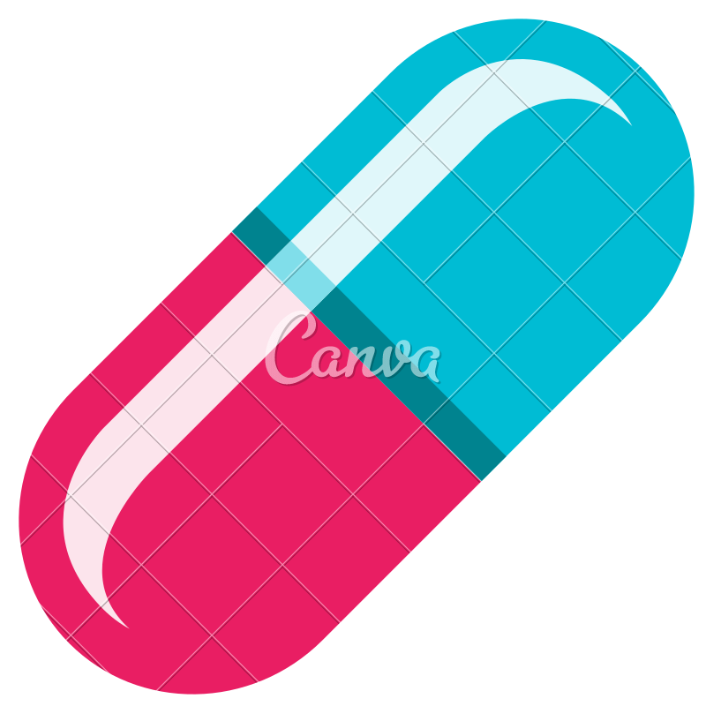
This device that automatically dispenses the right pill at the scheduled time.
Designed to help chronic patients, elderly, and caregivers. Reduces missed doses and overuse.
It provides reminders, alerts to refill.

Slide 4
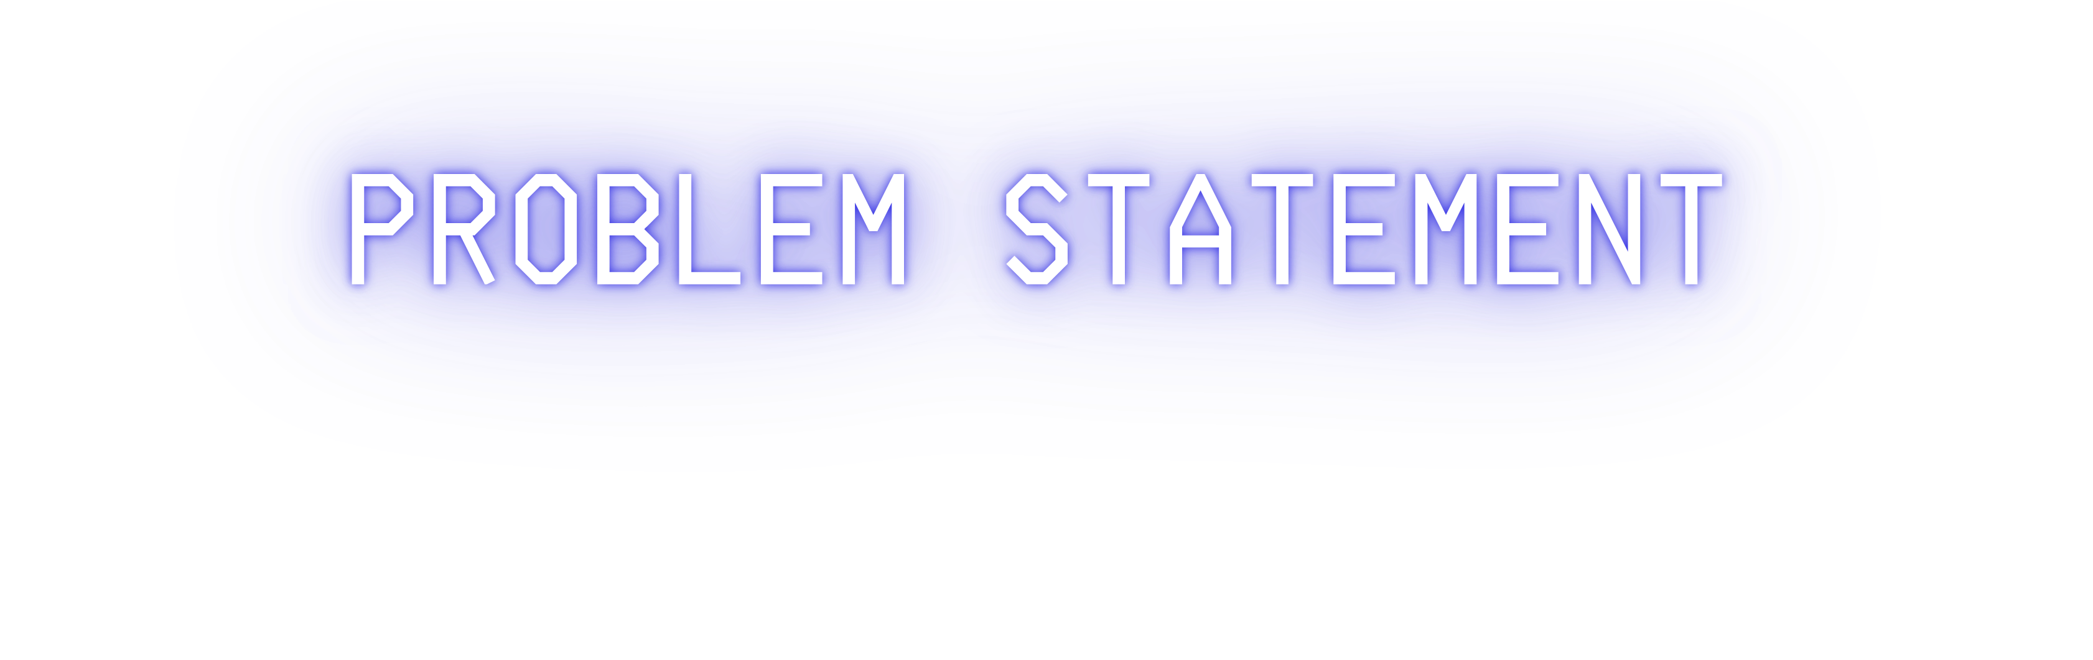

Many people forget to take their medicine on time.
Missed or incorrect doses can lead to serious health problems.
Need for Smart Solution
A smart system is required to ensure accurate and timely medicine intake.
Especially useful for elderly people, patients with memory issues, and chronic disease management.
Studies suggest that a 10% increase in medication adherence can lead to an 11% reduction in emergency room visits and a 6% decrease in avoidable hospitalizations.

Slide 5





AIM: To ensure timely, accurate, and automated medication management for improved patient compliance and safety.
To improve medication adherence: It helps patients take the right dose at the right time, reducing missed or incorrect doses.
To provide reminders and alerts: It sends notifications to patients and/or caregivers when it's time for a dose or if a dose has been missed.
To track medication usage: It records and logs medication intake, which can be shared with healthcare providers to monitor treatment effectiveness.
To prevent overdosing: By dispensing only the scheduled dose at the scheduled time, it helps prevent accidental overdoses.

Slide 6

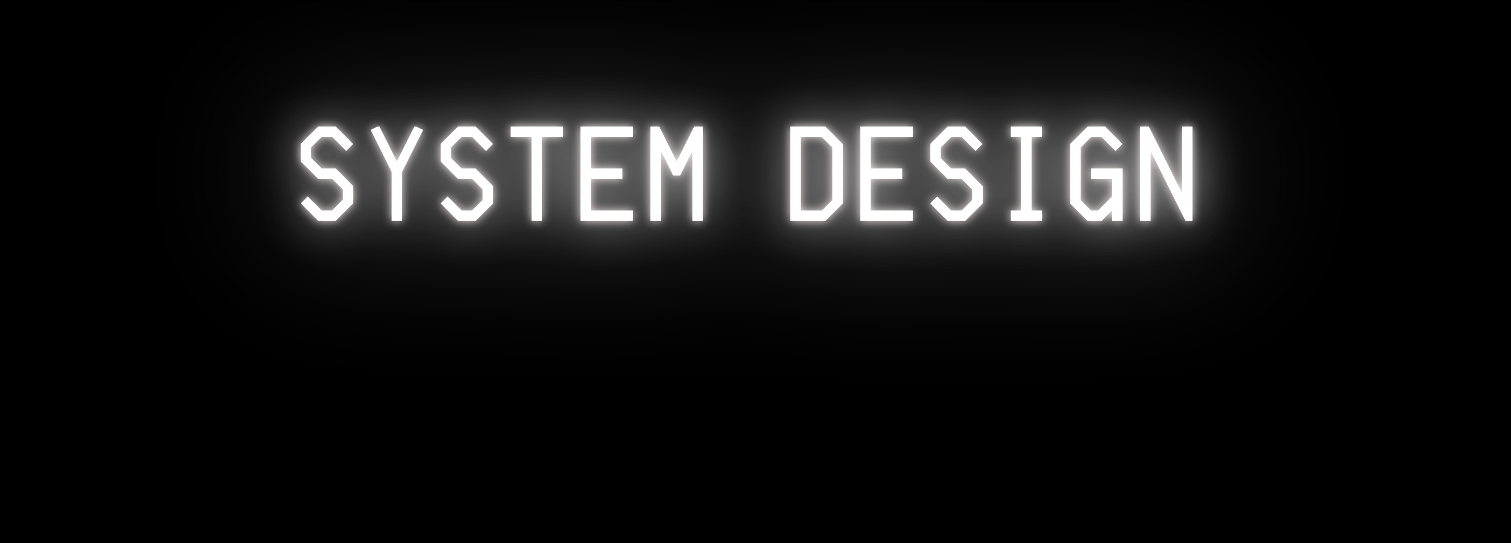
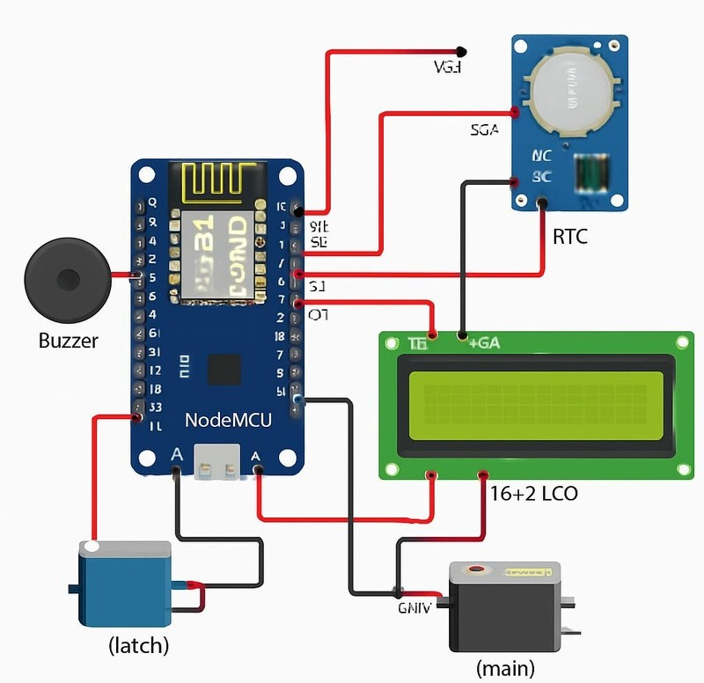
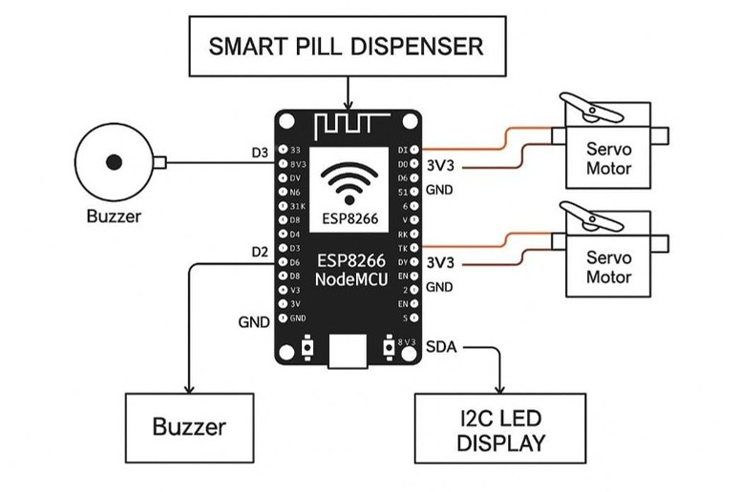

PIN CONNECTION
BLOCK DIAGRAM

Slide 7
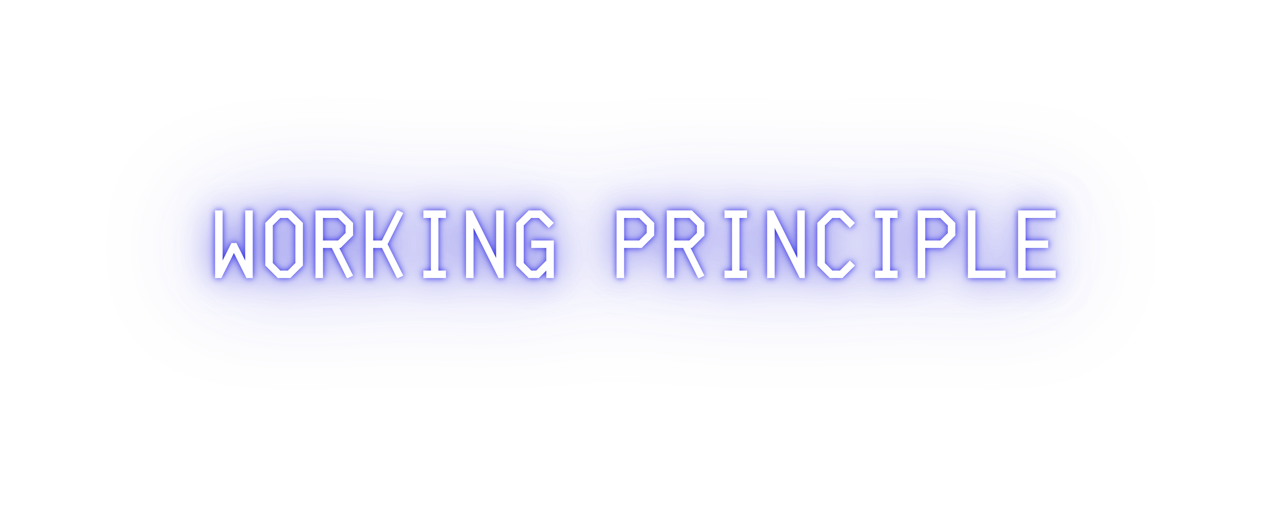







01
Time is Set:
02
03
04
05
Real-Time Tracking:
A Real Time Clock (RTC) module continuously tracks the current time.
Dispensing Mechanism:
At the scheduled time, a servo motor or rotating disk aligns the correct pill compartment.
Pills are automatically dispensed into the output tray.
User Notification:
A buzzer sounds or a display lights up to notify the user.
Missed Dose Handling: If the pill is not taken within a fixed time, the
device can issue a reminder or alert.
The user sets specific times for each medication dose using the mobile application.

Slide 8




ESP32 NODE MCU (8266)
Servo Motor
RTC Module (DS3231)
LCD Display (I2C) Buzzer Breadboard Connectors

Slide 9
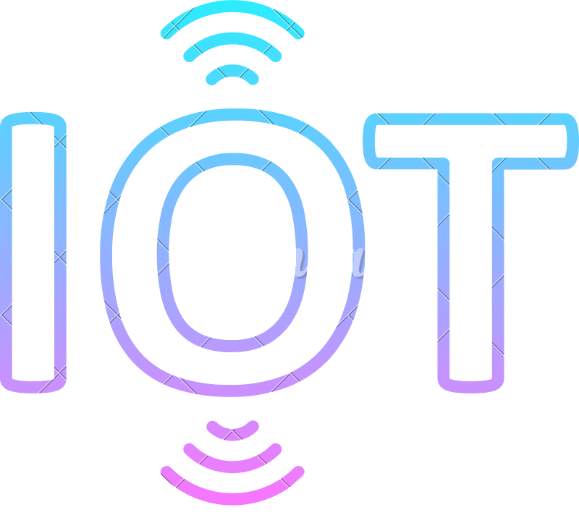
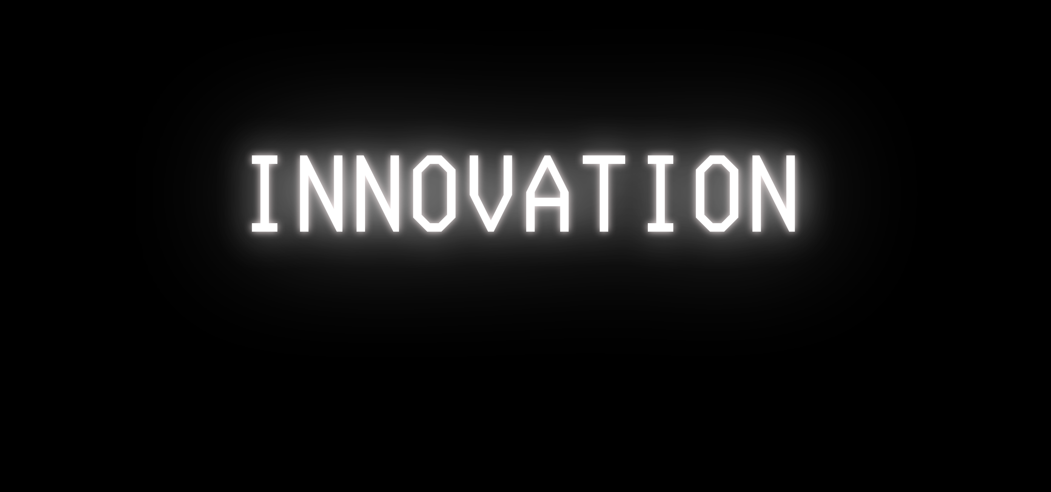

CREATIVE APPROACH: UNLIKE CONVENTIONAL PILL BOXES, OUR DESIGN INTEGRATES ESP8266 NODEMCU WITH IOT CAPABILITIES, ENABLING REMOTE MONITORING AND TIMELY NOTIFICATIONS.
DESIGN INNOVATION: THE USE OF SERVO MOTORS FOR PRECISION DISPENSING, AN I2C LED DISPLAY FOR USER-FRIENDLY INTERACTION, AND A BUZZER ALERT SYSTEM ENSURES ACCESSIBILITY FOR ALL AGE GROUPS, ESPECIALLY ELDERLY PATIENTS
IMPROVEMENT OVER EXISTING MODELS: TRADITIONAL DISPENSERS ONLY RELY ON MANUAL REMINDERS, WHILE OUR MODEL PROVIDES AUTOMATED SCHEDULING, ALERTS, AND REDUCED HUMAN ERROR..

Slide 10
FUTURE ENHANCEMENTS
MOBILE APP INTEGRATION:
MONITOR THE DEVICE VIA SMARTPHONE APPS FOR REMOTE SCHEDULING AND TRACKING.
VOICE ASSISTANCE:
USE VOICE COMMANDS TO OPERATE THE DISPENSER OR RECEIVE SPOKEN MEDICATION REMINDERS.
REGULAR CHECK-UP ALERTS:
THE DEVICE CAN REMIND USERS TO SCHEDULE OR ATTEND REGULAR DOCTOR VISITS.
IN-BUILT ALARM FOR LIQUID MEDICINES/VACCINES:
SET REMINDERS FOR NON-PILL MEDICATIONS LIKE SYRUPS, DROPS, OR VACCINES.
EMERGENCY SUPPORT:
SOS BUTTON INTEGRATED IN THE DEVICE TO NOTIFY CAREGIVER/DOCTOR IN EMERGENCIES.
AUTOMATIC ALERT SYSTEM:
ALERT USER/CAREGIVER IF MULTIPLE CONSECUTIVE DOSES ARE MISSED
BIOMETRIC AUTHENTICATION USE FINGERPRINT/FACE RECOGNITION :
TO ENSURE ONLY THE RIGHT PERSON ACCESSES THE PILLS.
PREVENTS MISUSE OR OVERDOSE.

Slide 11












Timely Medication:
Ensures pills are taken at the correct time, reducing the risk of missed or double doses.
Helpful for Elderly & Patients:
Especially useful for seniors or those with memory loss, Alzheimer’s, or chronic conditions.
Reduces Caretaker Dependence:
Patients can manage their medication more independently with automated reminders.
Improves Health Outcomes:
Better medication adherence leads to more effective treatment and faster recovery.

Slide 12
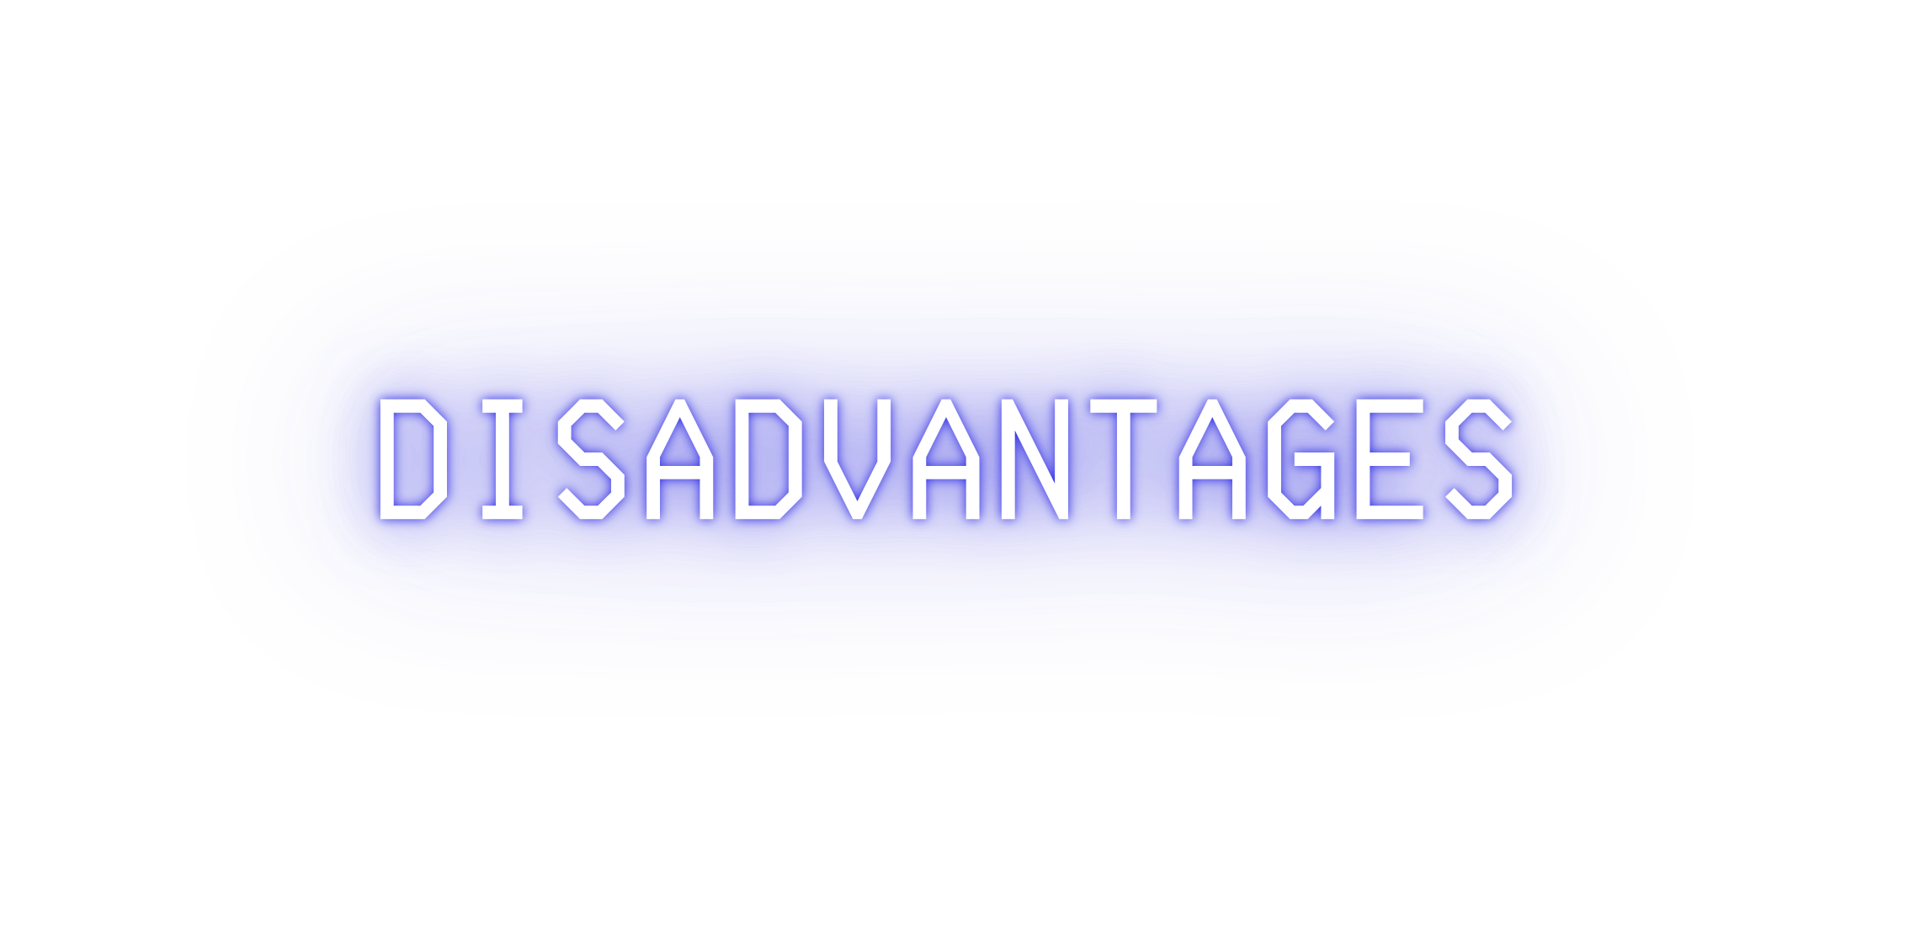







Contamination of the medicine:
Keeping the medicines out of the protective film may harm the hygiene and quality control
Wastage of medicine :
If in case there is a change in course , the tablets once taken out of the film may result in wastage.

Slide 13



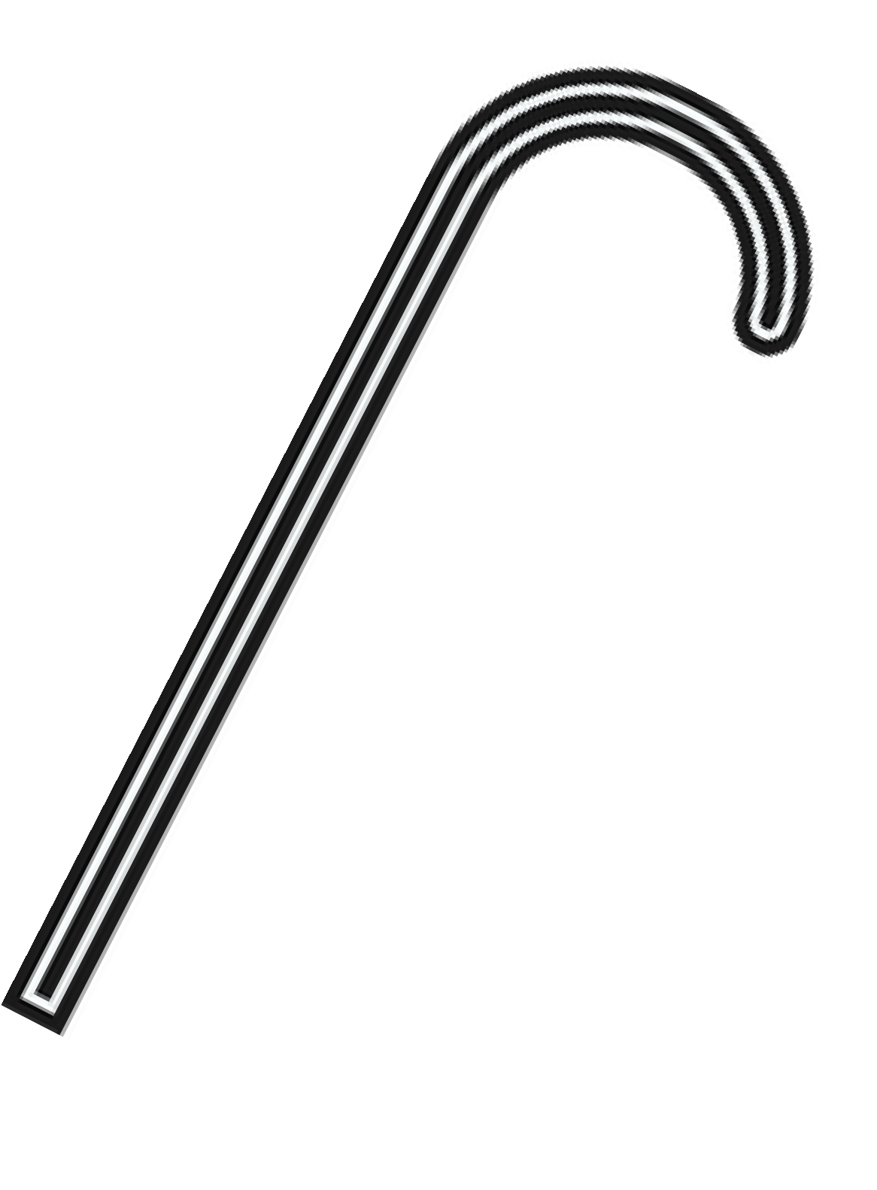

Hospitals & Clinics:
Used to manage multiple patients' medication schedules. Reduces human error and saves nursing time.
Home Use:
Perfect for elderly people, chronic patients, or busy individuals. Offers independence and ensures correct dosing.
Old Age Homes:
Caregivers can automate pill delivery for multiple residents. Ensures regular and accurate medicine intake.

Slide 14


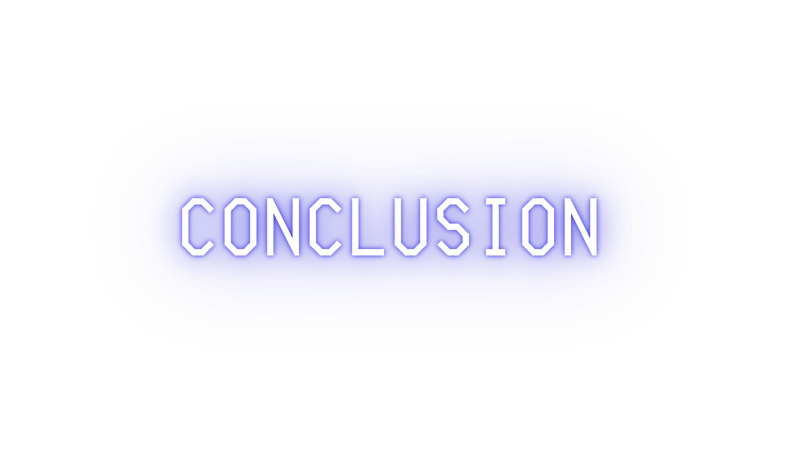








Smart Pill Dispenser ensure timely and accurate medication, reducing the risk of missed or incorrect doses, especially for elderly or chronically ill patients.
It is a reliable, user-friendly, and efficient healthcare solution that promotes independence and improves treatment outcomes.

Slide 15



